Slide 1
E-FishLandia
Submitted By
B1JR22

Slide 2
Abstract
FishLandia is an application for an E-Commerce store to buy varieties of fish online. It provides functionality both for a customer as well as an admin.
Admin is provided with complete access to the user and products database to make the desired changes to maintain the application.
On the other hand, the customer can create their user account and proceed with the shopping. They can view the product details and decide upon their purchase. This app also provides a feature to add items to the cart and enables the customer can make changes to their wish list before making the final purchase. The customer can make the payment with different types of payment options available. The order will get delivered to the address provided by the customer. And they will also receive a delivery status to track their order. Additionally, customers can also return the product and ask for a refund if the delivered product is not in a desirable condition.

Slide 3
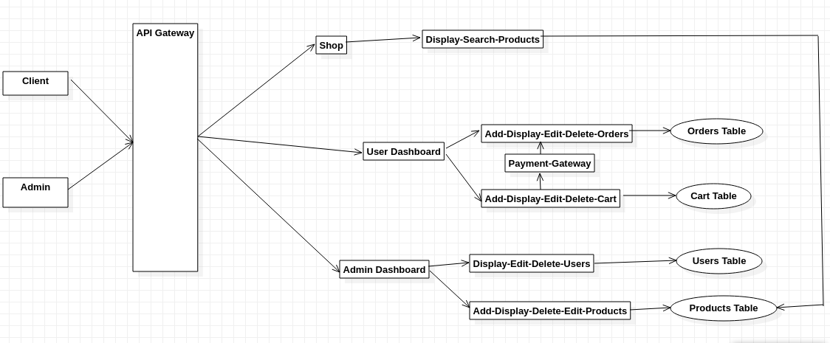
High Level Design

